Slide 1
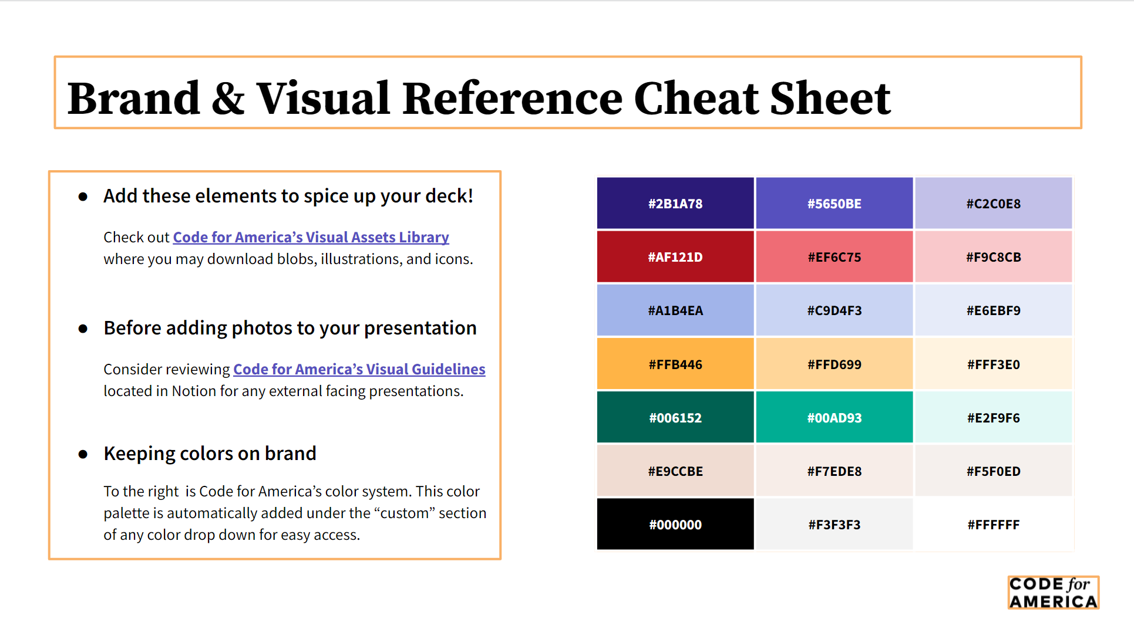
Code for America Visual Identity
Link to more info: https://codeforamerica.org/news/a-new-code-for-america-brand/

